Slide 1


GPM Education Playbook 2

Slide 2
Agenda
1. Part I: GPM Introduction
  Definition& Difference between Show GPM & Watch GPM
  Why should know Show GPM?
  Where can you check Show GPM?
2.Part II: GPM Guide
  Important actions that impact GPM
  1) Before Live
  2) During Live
  3) Overall GPM Checklist

Slide 3
Part I: Introduction

Slide 4
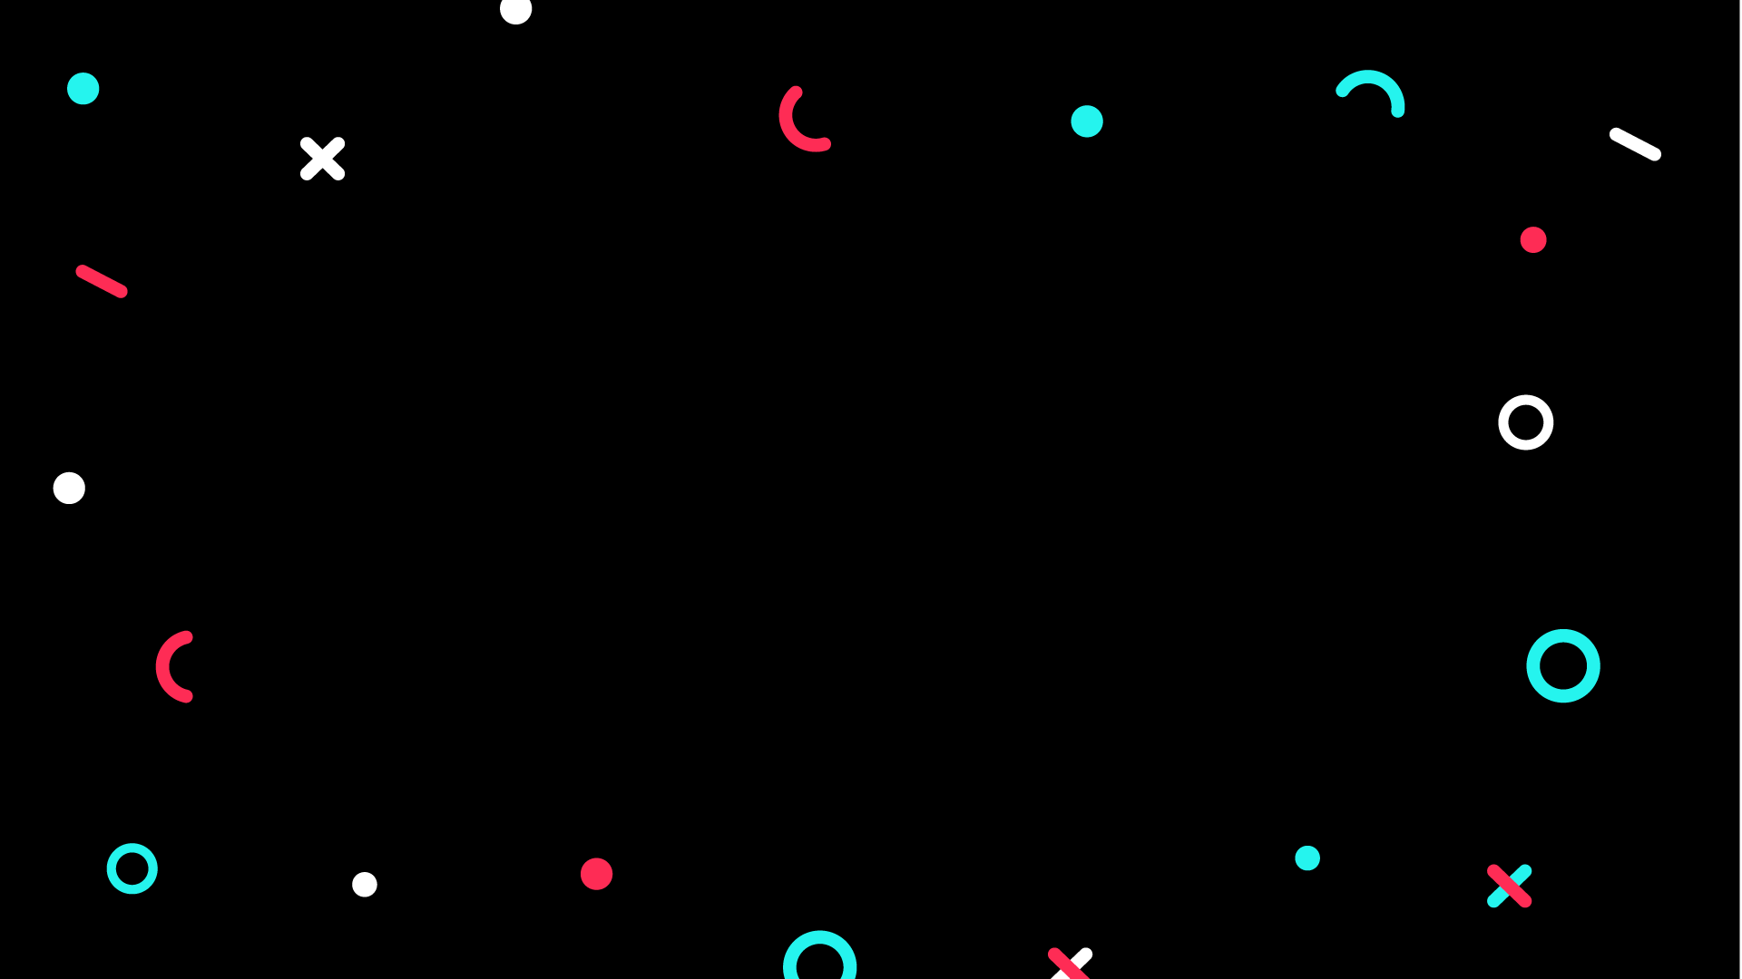

What is Show GPM?
C O N F I D E N T I A L & P R O P R I E T A R Y

Slide 5



Difference between Show GPM & Watch GPM
GMV = Watch PV x Watch GPM / 1,000
GMV = Show PV x Show GPM / 1,000
CONFIDENTIAL & PROPRIETARY
**GPM is a metric to measure the traffic effectiveness
Enter Room Rate * CTR * CO* AOV* 1000

Slide 6
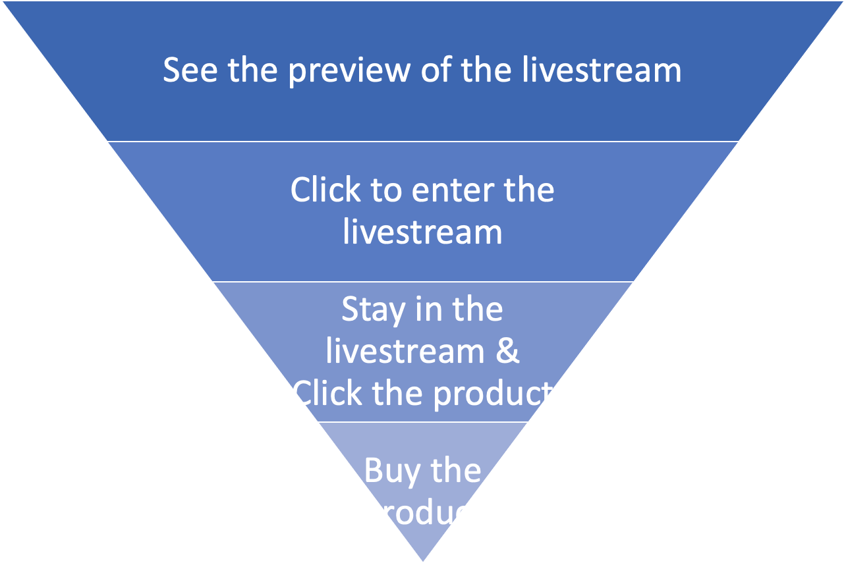
Why Show GPM is a Better Metrics compare to Watch GPM?
User Perspective
Show PV
Watch PV
CONFIDENTIAL & PROPRIETARY
Show GPM
** Note : Show GPM measure traffic effectiveness starting from whether users have interest to view your Live.
Watch GPM
CTR
Enter Room Rate * CTR * CO* AOV* 1000
C_O & AOV

Slide 7
Difference between Show GPM & Watch GPM
What is Live Show GPM?
Live Watch GPM
Live Show GPM
Enter Room Rate ***
CONFIDENTIAL & PROPRIETARY
Live CTR
Live CTR
Live CO
Live CO
AOV
AOV
Enter Room Rate * CTR * CO* AOV* 1000
Show GPM = Enter Room Rate x Live CTR x Live C_O x AOV
**Enter Room Rate - measure attractiveness of your Live!

Slide 8
Where can you check Show GPM
C O N F I D E N T I A L & P R O P R I E T A R Y

Slide 9


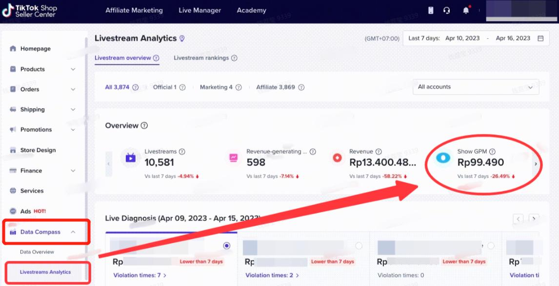
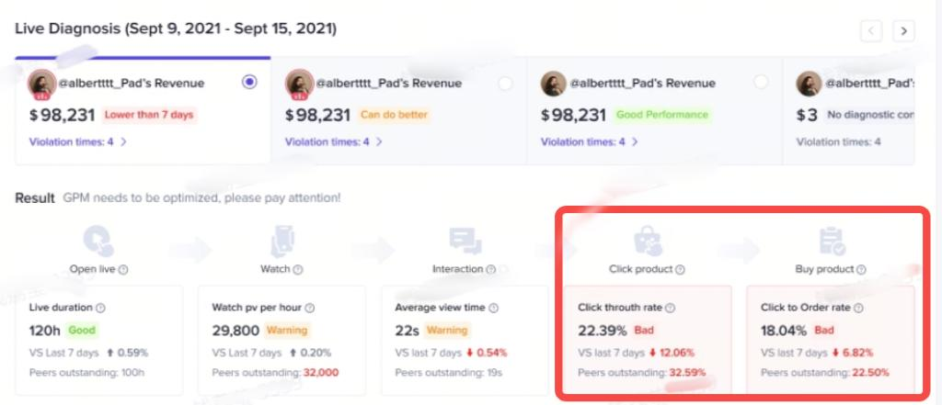
Creator / Seller Perspective
1
Data Compass > Livestream Analytics(Show GPM)
2
Data Compass > Live Diagnosis(CTR, C_O) with suggestion
Show GPM =Enter Room Rate * CTR*C_O*AOV*1000
Notes:
打开选项（跟粉丝互动）

Slide 10
Creator / Seller Perspective
3
TikTok Shop App-Creator tools
Step 1
Step 2
Step 3
Step 4
Step 5
Notes:
打开选项（跟粉丝互动）

Slide 11
Part II: GPM Guide

Slide 12
  Important actions that impact GPM
  1) Before Live
  2) During Live
  3) Overall Checklist
GPM Guide
Notes:
what are the preparation we can do to imporve our overall GPM score?
1. Before and during live
will provide an overall checklist as well
** sometimes we are too focused on selling and forgot about all these steps

Slide 13
Before LIVE
(ERR, CTR, C_O, Overall)
C O N F I D E N T I A L & P R O P R I E T A R Y

Slide 14
  Important actions that impact GPM
  1) Before Live
  ERR (Enter Room Rate)
  CTR
  C_O
  Overall Metrics
  2) During Live
  3) Overall Checklist
GPM Guide
Notes:
- what are the preparation to achive higher ERR

Slide 15
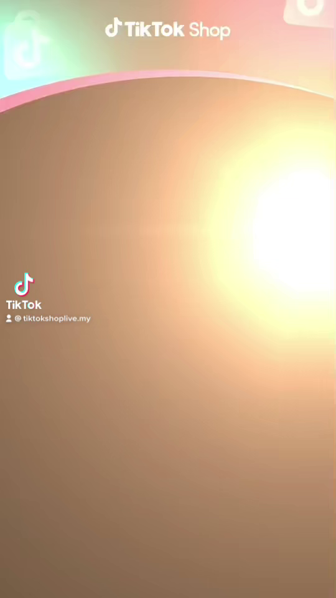
Important actions that impact GPM
1. ERR
Enter Room Rate = Watch PV / Show PV
2. CTR
Strategy 1
3.AOV
Pre-live post
4. C_O
Publish traffic-driving short videos (related to live) beforehand
Strong reminder for attracting more audience to enter the liveroom
Notes:
- to get more organic traffic

Slide 16
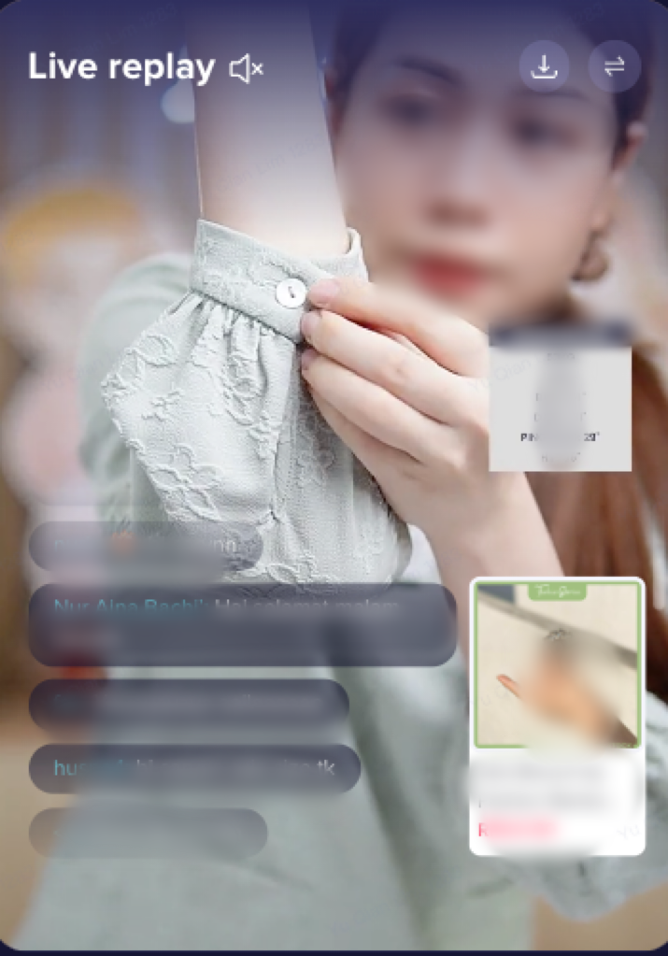
Important actions that impact GPM
1. ERR
Enter Room Rate = Watch PV / Show PV
2. CTR
Strategy 2
3.AOV
Liveroom visual preparation
Set good lighting without over/under exporsure
Ensure live image quality with good / normal pixel, which would attract and keep more audience to enter and stay in the LIVE room
4. C_O

Slide 17
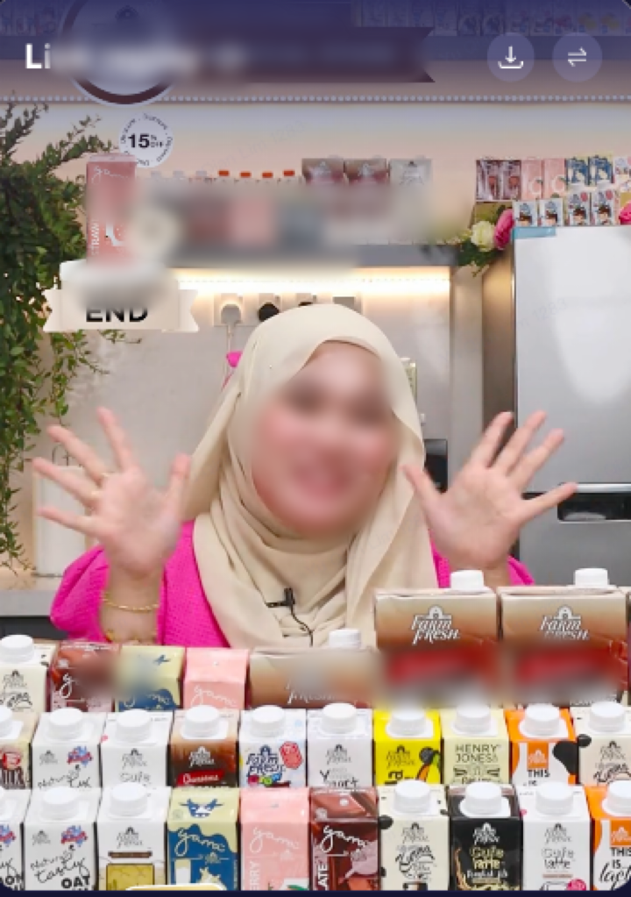
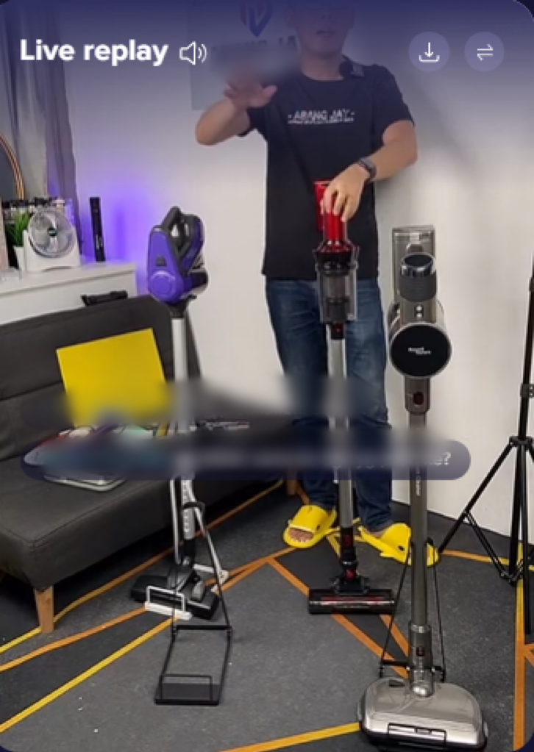
Important actions that impact GPM
Choose suitable equipment to ensure LIVE image quality
1. ERR
Lighting: Provide even, diffused lighting without creating harsh shadows. Adjustable LED lights with color temperature control can also help create the desired ambiance for different beauty products.
2. CTR
3.AOV
4. C_O
Tripod with a movable arm or an overhead rig to capture different angles or demonstrate product functionality.

Slide 18
  Important actions that impact GPM
  1) Before Live
  ERR (Enter Room Rate)
  CTR
  C_O
  Overall Metrics
  2) During Live
  3) Overall Checklist
GPM Guide

Slide 19
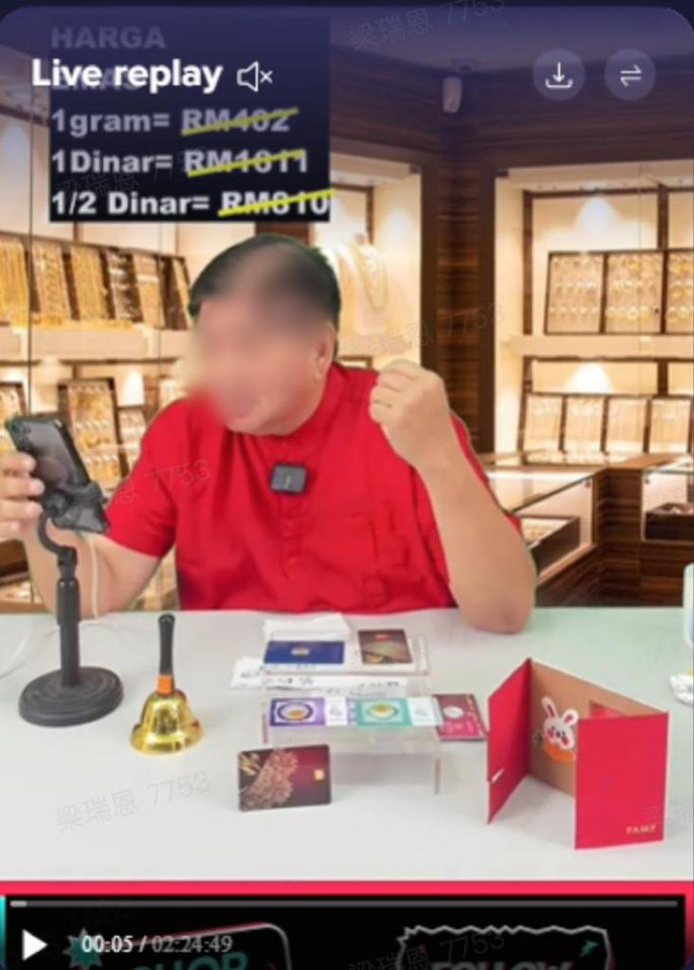
Important actions that impact GPM
1. ERR
Enter Room Rate = Watch PV / Show PV
CTR=Click-Through-Rate
2. CTR
Strategy 3
3.AOV
Liveroom background display
4. C_O
Set neat and organised background
Ensure liveroom decoration fits the products to attract more audience to click in our LIVE room and products

Slide 20
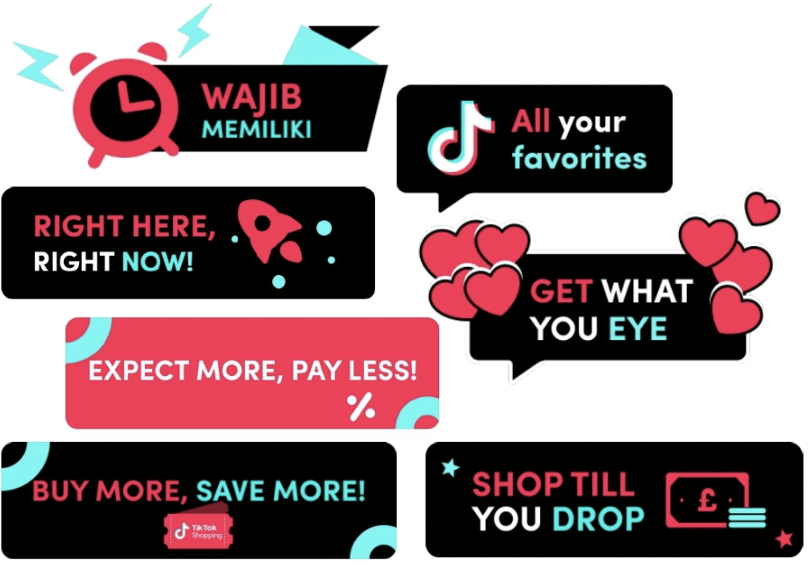
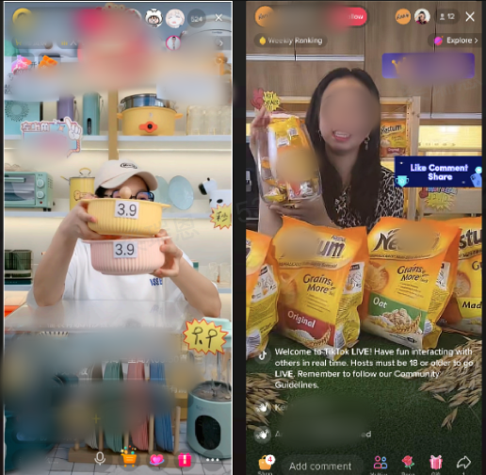
Important actions that impact GPM
1. ERR
Enter Room Rate = Watch PV / Show PV
CTR=Click-Through-Rate
2. CTR
Strategy 4
3.AOV
Liveroom background display
4. C_O
Use signage / sticker to display key offers / promotions
to ensure all the promotion points clear to the audience and attract them to click in the LIVE and products

Slide 21
  Important actions that impact GPM
  1) Before Live
  ERR (Enter Room Rate)
  CTR
  C_O
  Overall Metrics
  2) During Live
  3) Overall Checklist
GPM Guide

Slide 22
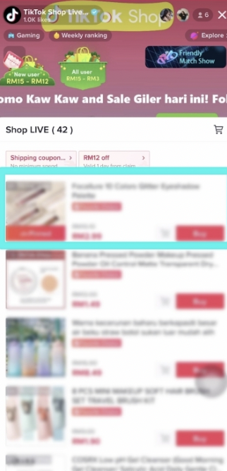
Important actions that impact GPM
CTR=Click-Through-Rate
1. ERR
C_O: Click to order
2. CTR
Strategy 5
3.AOV
Liveroom product preparation
Always bind high GPM or top selling products
Bind >=10 products per live
4. C_O
Always bind high GPM or top selling products
Bind >=10 products per live
Binding => 10 products per live is to provide a more variety of products for viewers to click in and purchase
Notes:
- prepare and survey best selling products to bind into the live,
- say if wanna test the products, can add those new products just to test out but not majority

Slide 23
  Important actions that impact GPM
  1) Before Live
  ERR (Enter Room Rate)
  CTR
  C_O
  Overall Metrics
  2) During Live
  3) Overall Checklist
GPM Guide

Slide 24
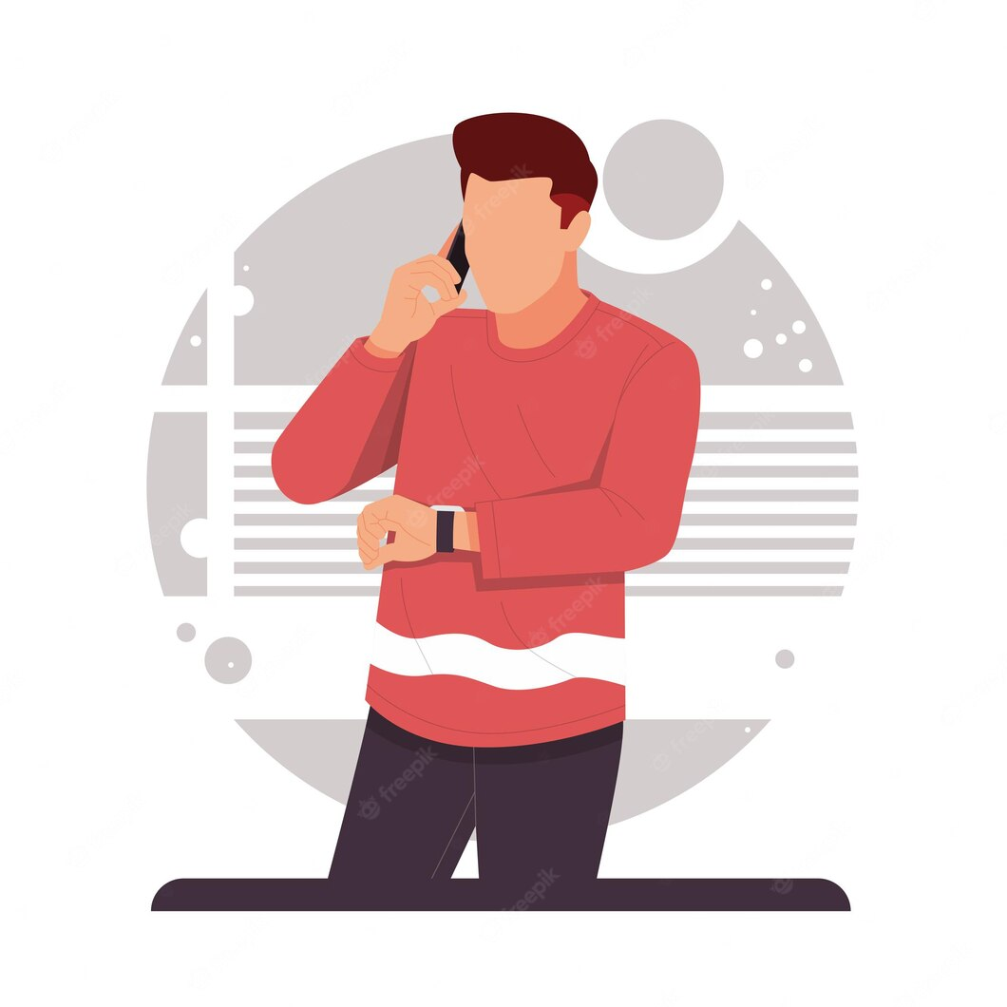
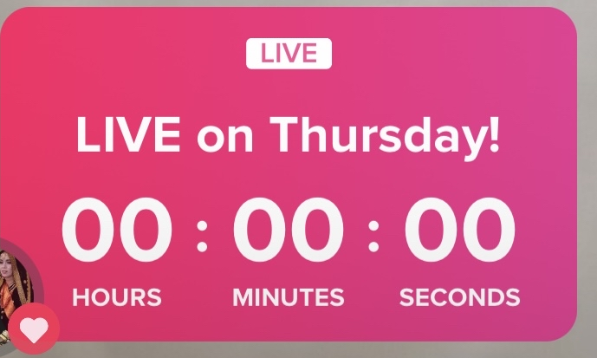
Important actions that impact GPM
1. ERR
Enter Room Rate = Watch PV / Show PV
2. CTR
Strategy 1
3.AOV
Liveroom airdate
Guarantee proper live duration (mainly top sellers/creators); at least 3 hours;
Deepen connection with their audience and create a loyal fan base
4. C_O

Slide 25
During LIVE
(CTR, C_O, AOV)
C O N F I D E N T I A L & P R O P R I E T A R Y

Slide 26
  Important actions that impact GPM
  1) Before Live
  2) During Live
  ERR (Enter Room Rate)
  CTR
  C_O
  AOV
  3) Overall Checklist
GPM Guide

Slide 27
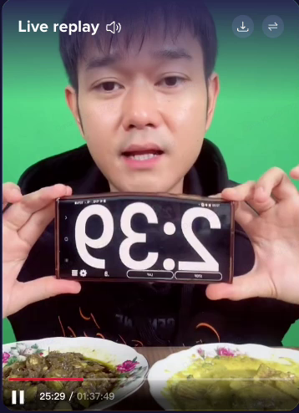
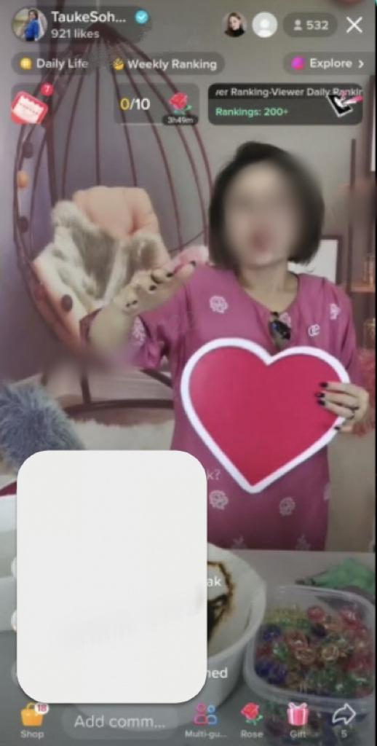
Important actions that impact GPM
CTR=Click-Through-Rate
1. ERR
C_O: Click to order
2. CTR
Strategy 1
3.AOV
Liveroom interaction
Always bind high GPM or top selling products
Bind >=10 products per live
4. C_O
Guide viewers to click the shopping cart => increase CTR
Encourage viewers to interact through like, follow, share and comment
Host be responsive to viewers' questions
Host call to action
Notes:
- host to interact with viewers more frequently
(for example, cue viewres to comment, like & share if they want our RM1 flash deal etc

Slide 28
  Important actions that impact GPM
  1) Before Live
  2) During Live
  ERR (Enter Room Rate)
  CTR
  C_O
  AOV
  3) Overall Checklist
GPM Guide

Slide 29
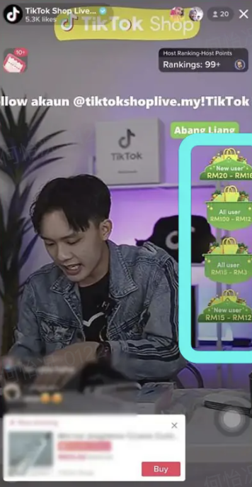
Important actions that impact GPM
CTR=Click-Through-Rate
1. ERR
AOV=average price x purchase unit per order
C_O: Click to order
2. CTR
Strategy 1
3.AOV
Liveroom interaction
Use promotion tools: voucher, bundle, flash sales, free giveaway (advanced: create limited time offers)
Always bind high GPM or top selling products
Bind >=10 products per live
4. C_O
Use promotion tools: voucher, bundle, flash sales...(advanced: create limited time offers)
These promotion tools will urge the audience potential to click in, to view and purchase the products during LIVE
Notes:
- to cue viewers to check yellow cart to see if the price is really the price we are selling
- If they saw the price then have to purchase dy, else the promo will be gone

Slide 30
  Important actions that impact GPM
  1) Before Live
  2) During Live
  ERR (Enter Room Rate)
  CTR
  C_O
  AOV
  3) Overall Checklist
GPM Guide

Slide 31
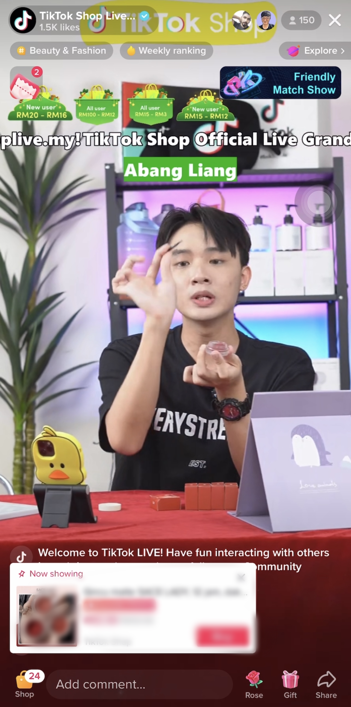
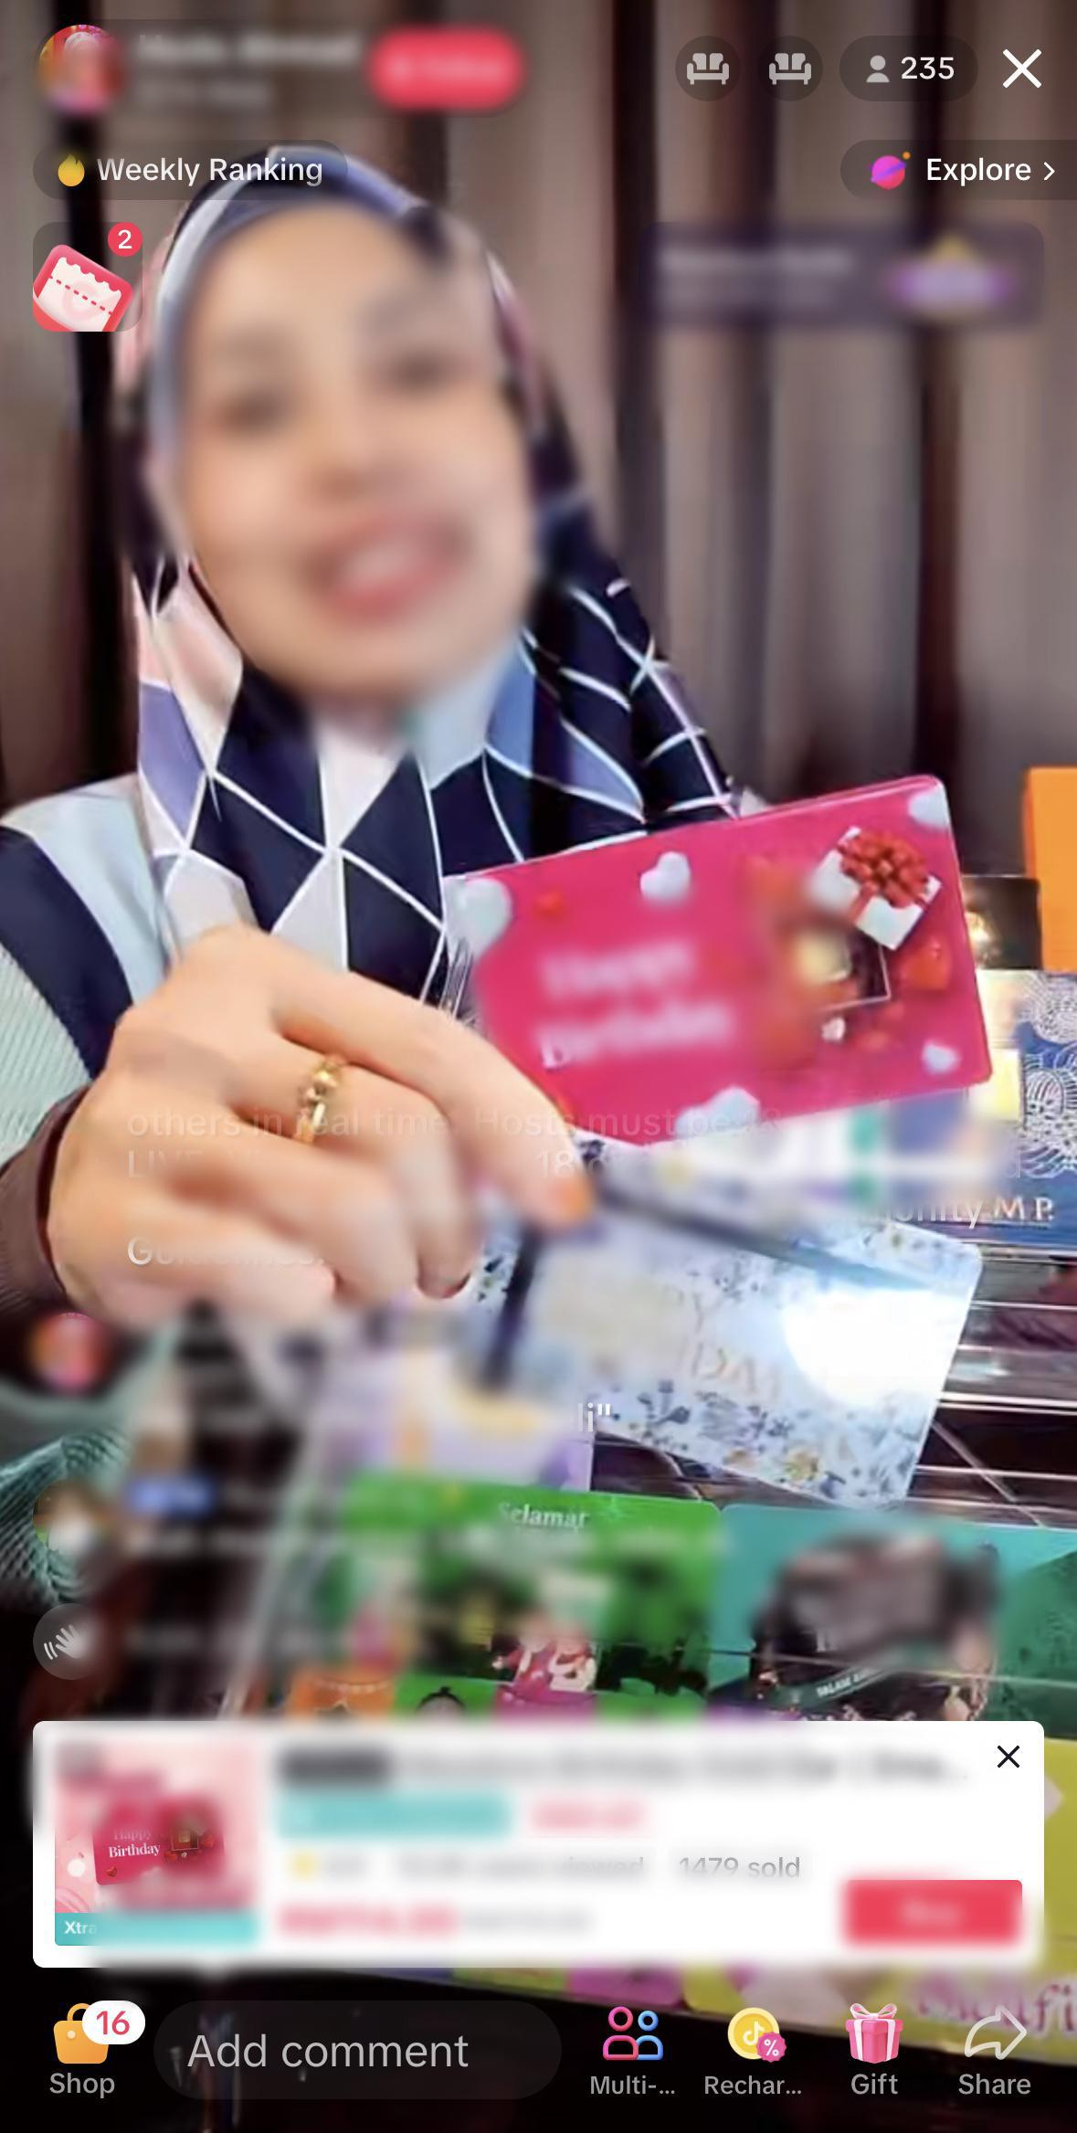
Important actions that impact GPM
CTR=Click-Through-Rate
1. ERR
C_O: Click to order
2. CTR
Strategy 2
3.AOV
Liveroom products presentation
Always bind high GPM or top selling products
Bind >=10 products per live
4. C_O
Pin product ontime while explaining the product, which helps get more attention from viewers to check on that product
Host increase the explanation & pin time and frequency of top selling products to push sales.
Host explain products features and selling points thoroughly
Use promotion tools: voucher, bundle, flash sales, free giveaway (advanced: create limited time offers)
Notes:
- to cue customer to Click order to get the voucher & purchase
- our countries's creator's pin time is lower compared to other SEA countries, hence we have to encourage them to pin more frequently
- to cue viewers to check yellow cart to see if the price is really the price we are selling
- If they saw the price then have to purchase dy, else the promo will be gone

Slide 32
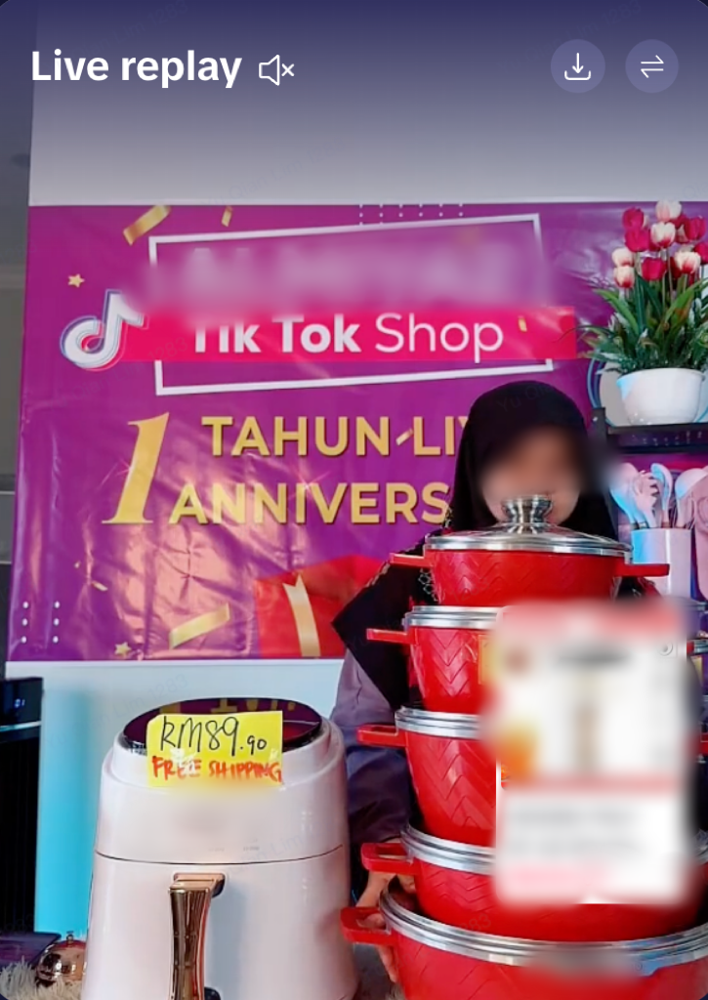
Important actions that impact GPM
CTR=Click-Through-Rate
1. ERR
C_O: Click to order
2. CTR
Strategy 2
3.AOV
Liveroom products presentation
Host create shopping atmosphere with strong enthusiasm, especially during some special holidays/festivals
for example, music, light, promo stickers...
Always bind high GPM or top selling products
Bind >=10 products per live
4. C_O
Use promotion tools: voucher, bundle, flash sales, free giveaway (advanced: create limited time offers)
Notes:
- to utilise on KT boards
- OBS user, utilise the campaign stickers campaign team provided
- to have their own set schedule during BAUs (to utilise on our category day) -- to create followers loyalty

Slide 33
  Important actions that impact GPM
  1) Before Live
  2) During Live
  ERR (Enter Room Rate)
  CTR
  C_O
  AOV
  3) Overall GPM Checklist
GPM Guide
Notes:
- most imprtant is what catches the viewer's eyesight and make them click into the live

Slide 34
Overall GPM Checklist
Stage | GPM metrics | Action Type | Action Item | Notes
Before Live | Overall | Liveroom airdate | Guarantee proper live duration (mainly top sellers/creators) | Longer livestream durations allow top creators to provide more value to their viewers. It also present monetization opportunities and help to maintain their brand reputation
Before Live | ERR | Pre-live post | Publish traffic-driving short videos (related to live) beforehand | It can create buzz and generate excitement among viewers. It can help reach a broader audience, give creators the opportunity to showcase their expertise in the field and build credibility among their audience.
Before Live | ERR | Liveroom visual preparation | Set good lighting without over/under exporsure | Make sure it’s consistent across all light sources. Mixing color temperatures produces a poor-quality video.
Before Live | ERR |  | Ensure live image quality with good / normal pixel | High-quality live image quality allows for detailing. It enables creators to show intricate details of the product or service being promoted easily.
Before Live | ERR | Liveroom background display | Set neat and organised background
Before Live | ERR |  | Ensure liveroom decoration fits the products
Before Live | ERR,CTR |  | Use signage / sticker to display key offers / promotions
Before Live | CTR,C_O | Liveroom product preparation | Always bind high GPM or top selling products | Do not simply choose any products to be bound in live but select those proven sales record products (high GPM or top selling products) to push more sales.
Before Live | CTR,C_O |  | Bind >=10 products per live | The purpose of proposing bind => 10 products per live is to provide more variety of products for viewers to purchase.

Slide 35
Overall GPM Checklist
Stage | GPM metrics | Action Type | Action Item | Notes
During Live | CTR | Liveroom interaction | Guide viewers to click the shopping cart
During Live | CTR,C_O |  | Encourage viewers to interact through like, follow, share and comment
During Live | CTR,C_O |  | Host be responsive to viewers' questions | Provide clear information; Provide comprehensive answers ;Keep track of frequently asked questions
During Live | CTR,C_O |  | Host call to action | Use Countdown timers; Time-limited offers;Use action-oriented phrases, such as "Add to Cart" or "Buy Now" to encourage customers to make a purchase.
During Live | CTR,C_O,AOV |  | Use promotion tools: voucher, bundle, flash sales etc. (advanced: create limited time offers) | Have a clear strategy in mind and to communicate the promotion effectively through your marketing channels. Make sure the promotion is easy to understand and use.
During Live | CTR | Liveroom products presentation | Pin product ontime while explaining the product | Pin the product while sellers/creators are explaining it helps to get more attention from viewers to check on that product.
During Live | CTR |  | Host increase the explanation time and frequency of high GPM or top selling products | Sellers/Creators are suggested to check their hot selling product during live and pin + explain more on those hot selling products in order to push sales.
During Live | CTR,C_O |  | Host explain products features and selling points thoroughly
During Live | CTR,C_O |  | Host create shopping atmosphere with strong enthusiasm

Slide 36

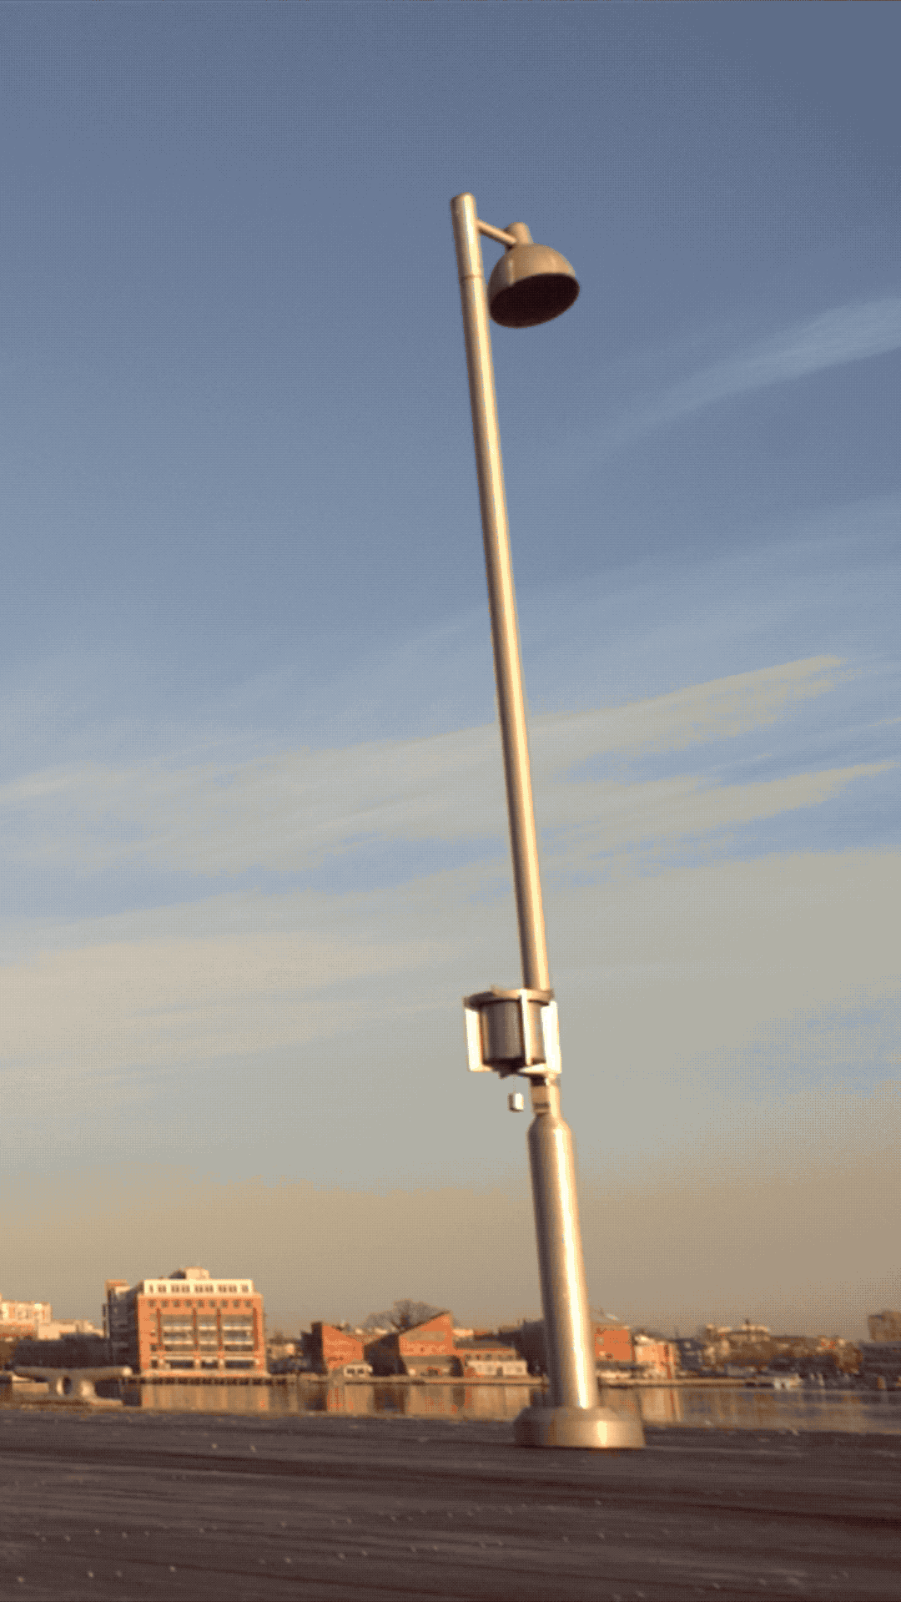
Let’s start now, we’re waiting for you!
C O N F I D E N T I A L & P R O P R I E T A R Y

